Slide 1

INTRODUCTION TO
DATA MINING
SUSHIL
KULKARNI

Slide 2

INTENSIONS
Define data mining in brief. What are the misunderstanding about data mining?
List different steps in data mining analysis.
What are the different area required to expertise data mining?
Explain how data mining algorithm is developed?
Differentiate data base and data mining process
SUSHIL KULKARNI

Slide 3
DATA
SUSHIL KULKARNI

Slide 4
DATA
The Data
Massive, Operational, and opportunistic
Data is growing at a phenomenal rate
SUSHIL KULKARNI

Slide 5
DATA
Since 1963
Moore’s Law :
The information density on silicon integrated circuits double every 18 to 24 months
Parkinson’s Law :
Work expands to fill the time available for its completion
SUSHIL KULKARNI

Slide 6
DATA
Users expect more sophisticated
information
How?
UNCOVER HIDDEN INFORMATION
DATA MINING
SUSHIL KULKARNI

Slide 7
DATA MINING
DEFINITION
SUSHIL KULKARNI

Slide 8
DEFINE DATA MINING
Data Mining is:
The efficient discovery of previously unknown, valid, potentially useful, understandable patterns in large datasets
The analysis of (often large) observational data sets to find unsuspected relationships and to summarize the data in novel ways that are both understandable and useful
to the data owner
SUSHIL KULKARNI

Slide 9
FEW TERMS
Data: a set of facts (items) D, usually stored in a database
Pattern: an expression E in a language L, that describes a subset of facts
Attribute: a field in an item i in D.
Interestingness: a function I_{D,L} that maps an expression E in L into a measure space M
SUSHIL KULKARNI

Slide 10
FEW TERMS
The Data Mining Task:
For a given dataset D, language of facts L,
interestingness function I_{D,L} and threshold
c, find the expression E such that I_{D,L}(E) > c
efficiently.
SUSHIL KULKARNI

Slide 11
EXAMPLE OF LAGE DATASETS
Government: IGSI, …
Large corporations
  WALMART: 20M transactions per day
  MOBIL: 100 TB geological databases
  AT&T 300 M calls per day
Scientific
  NASA, EOS project: 50 GB per hour
  Environmental datasets
SUSHIL KULKARNI

Slide 12
EXAMPLES OF DATA MINING APPLICATIONS
Fraud detection: credit cards, phone cards
Marketing: customer targeting
Data Warehousing: Walmart
Astronomy
Molecular biology
SUSHIL KULKARNI

Slide 13
THUS : DATA MINING
Advanced methods for exploring and
modeling relationships in large amount
of data
SUSHIL KULKARNI

Slide 14
THUS : DATA MINING
Finding hidden information in a database
Fit data to a model
Similar terms
  Exploratory data analysis
  Data driven discovery
  Deductive learning
SUSHIL KULKARNI

Slide 15
NUGGETS
SUSHIL KULKARNI

Slide 16
NUGGETS
“ IF YOU’VE GOT TERABYTES OF DATA,
AND YOU ARE RELYING ON DATA MINING
TO FIND INTERESTING THINGS IN THERE
FOR YOU, YOU’VE LOST BEFORE YOU’VE3
EVEN BEGUN”
- HERB EDELSTEIN
SUSHIL KULKARNI

Slide 17
NUGGETS
“ ….. You really need people who understand what it is they are looking for and what they can do with it once they find it ”
- BECK (1997)
SUSHIL KULKARNI

Slide 18
PEOPLE THINK
Data mining means magically discovering
hidden nuggets of information without
having to formulate the problem and without
regard to the structure or content of the data
SUSHIL KULKARNI

Slide 19
DATA MINING PROCESS
SUSHIL KULKARNI

Slide 20
The Data Mining Process
Understand the Domain
- Understands particulars of the business or scientific problems
Create a Data set
- Understand structure, size, and format of data
- Select the interesting attributes
- Data cleaning and preprocessing
SUSHIL KULKARNI

Slide 21
The Data Mining Process
Choose the data mining task and the specific algorithm
- Understand capabilities and limitations of algorithms that may be relevant to the problem
Interpret the results, and possibly return to bullet 2
SUSHIL KULKARNI

Slide 22
EXAMPLE
Specify Objectives
- In terms of subject matter
Example :
Understand customer base
Re-engineer our customer retention strategy
Detect actionable patterns
SUSHIL KULKARNI

Slide 23
EXAMPLE
2. Translation into Analytical Methods
Examples :
Implement Neural Networks
Apply Visualization tools
Cluster Database
3. Refinement and Reformulation
SUSHIL KULKARNI

Slide 24
DATA MINNING QUERIES
SUSHIL KULKARNI

Slide 25
DB VS DM PROCESSING
Query
  Well defined
  SQL
Query
  Poorly defined
  No precise query language
Data
  Operational data
Data
  Not operational data
Output
  Precise
  Subset of
  database
Output
  Fuzzy
  Not a subset
  of database
SUSHIL KULKARNI

Slide 26
QUERY EXAMPLES
Database
Data Mining
Find all credit applicants with first name of Sane.
  Identify customers who have purchased
  more than Rs.10,000 in the last month.
        Find all customers who have purchased milk
  Find all credit applicants who are poor
  credit risks. (classification)
        Identify customers with similar buying
        habits. (Clustering)
        Find all items which are frequently
        purchased with milk. (association rules)
SUSHIL KULKARNI

Slide 27

INTENSIONS
Write short note on KDD process. How it is different then data mining?
Explain basic data mining tasks
Write short note on:
1. Classification 2. Regression
3. Time Series Analysis 4. Prediction
5. Clustering 6. Summarization
7. Link analysis
SUSHIL KULKARNI

Slide 28
KDD PROCESS
SUSHIL KULKARNI

Slide 29
KDD PROCESS
Knowledge discovery in databases
(KDD) is a multi step process of finding
useful information and patterns in data
while Data Mining is one of the steps in
KDD of using algorithms for extraction of
patterns
SUSHIL KULKARNI

Slide 30
STEPS OF KDD PROCESS
1. Selection-
Data Extraction -Obtaining Data from heterogeneous data sources -Databases, Data warehouses, World wide web or other information repositories.
2. Preprocessing-
Data Cleaning- Incomplete , noisy, inconsistent data to be cleaned- Missing data may be ignored or predicted, erroneous data may be deleted or corrected.
SUSHIL KULKARNI

Slide 31
STEPS OF KDD PROCESS
3. Transformation-
Data Integration- Combines data from multiple sources into a coherent store -Data can be encoded in common formats, normalized, reduced.
4. Data mining –
Apply algorithms to transformed data an extract
patterns.
SUSHIL KULKARNI

Slide 32
STEPS OF KDD PROCESS
5. Pattern Interpretation/evaluation
Pattern Evaluation- Evaluate the interestingness of resulting patterns or apply interestingness measures to filter out discovered patterns.
Knowledge presentation- present the mined knowledge- visualization techniques can be used.
SUSHIL KULKARNI

Slide 33
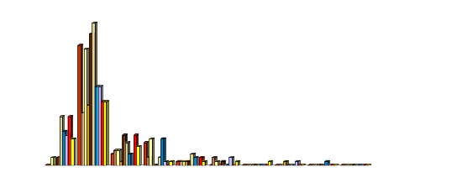
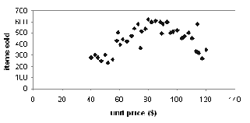
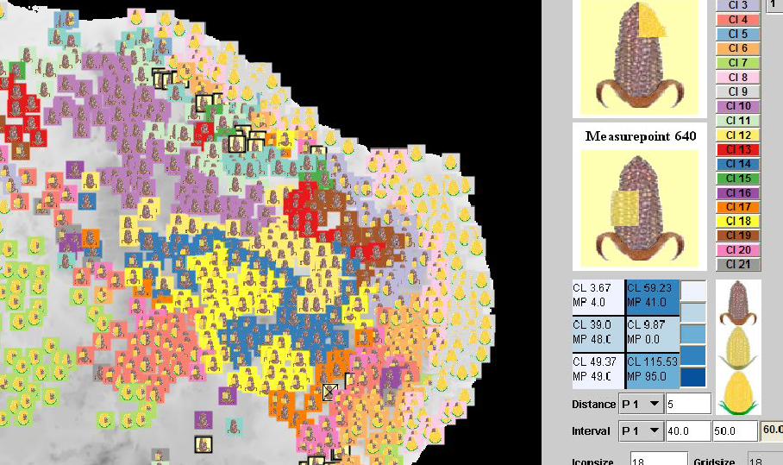
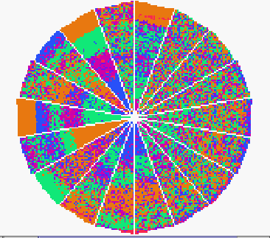
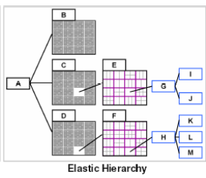
VISUALIZATION TECHNIQUES
Graphical-bar charts,pie charts histograms | Geometric-boxplot, scatter plot
Icon-based- using colors figures as icons | Pixel-based- data as colored pixels
Hierarchical- Hierarchically dividing display area | Hybrid- combination of above approaches

Slide 34
        KDD PROCESS
Knowledge
KDD is the nontrivial extraction of implicit previously unknown and potentially useful knowledge from data
Pattern Evaluation
Data Mining
Data Transformation
Data Warehouses
Data Preprocessing
Data Integration
Data Cleaning
Selection
Operational Databases
SUSHIL KULKARNI

Slide 35
KDD PROCESS EX: WEB LOG
Selection:
Select log data (dates and locations) to use
Preprocessing:
  Remove identifying URLs
  Remove error logs
Transformation:
  Sessionize (sort and group)
SUSHIL KULKARNI

Slide 36
KDD PROCESS EX: WEB LOG
Data Mining:
  Identify and count patterns
  Construct data structure
Interpretation/Evaluation:
  Identify and display frequently accessed
  sequences.
Potential User Applications:
  Cache prediction
  Personalization
SUSHIL KULKARNI

Slide 37
DATA MINING VS. KDD
Knowledge Discovery in Databases (KDD)
- Process of finding useful information and
patterns in data.
Data Mining: Use of algorithms to extract the information and patterns derived by the KDD process.
SUSHIL KULKARNI

Slide 38
KDD ISSUES
Human Interaction
Over fitting
Outliers
Interpretation
Visualization
Large Datasets
High Dimensionality
SUSHIL KULKARNI

Slide 39
KDD ISSUES
Multimedia Data
Missing Data
Irrelevant Data
Noisy Data
Changing Data
Integration
Application
SUSHIL KULKARNI

Slide 40
DATA MINING TASKS AND METHODS
SUSHIL KULKARNI

Slide 41
ARE ALL THE ‘DISCOVERED’ PATTERNS INTERESTING?
Interestingness measures:
A pattern is interesting if it is easily
understood by humans, valid on new or
test data with some degree of certainty,
potentially useful, novel, or validates
some hypothesis that a user seeks to
confirm
SUSHIL KULKARNI
Notes:
A data mining system/query may generate thousands of patterns, not all of them are interesting.
Suggested approach: Human-centered, query-based, focused mining

Slide 42
ARE ALL THE ‘DISCOVERED’ PATTERNS INTERESTING?
Objective vs. subjective interestingness measures:
  Objective: based on statistics and structures of patterns, e.g., support, confidence, etc.
  Subjective: based on user’s belief in the data, e.g., unexpectedness, novelty, actionability, etc.
SUSHIL KULKARNI
Notes:
A data mining system/query may generate thousands of patterns, not all of them are interesting.
Suggested approach: Human-centered, query-based, focused mining

Slide 43
CAN WE FIND ALL AND ONLY INTERESTING PATTERENS?
Find all the interesting patterns:
completeness
  Can a data mining system find all the interesting patterns?
  Association vs. classification vs. clustering
SUSHIL KULKARNI

Slide 44
CAN WE FIND ALL AND ONLY INTERESTING PATTERENS?
Search for only interesting patterns: Optimization
  Can a data mining system find only the interesting patterns?
  Approaches
    First general all the patterns and then filter out the uninteresting ones.
    Generate only the interesting patterns—mining query optimization
SUSHIL KULKARNI

Slide 45
Data Mining
Predictive
Descriptive
Clustering
Classification
Sequence Discovery
Prediction
Summarization
Regression
Association rules
Time series Analysis
SUSHIL KULKARNI

Slide 46
Data Mining Tasks
  Classification: learning a function that maps an item into one of a set of predefined classes
  Regression: learning a function that maps an item to a real value
  Clustering: identify a set of groups of similar items
SUSHIL KULKARNI

Slide 47
Data Mining Tasks
Dependencies and associations:
identify significant dependencies between data attributes
Summarization: find a compact description of the dataset or a subset of the dataset
SUSHIL KULKARNI

Slide 48
Data Mining Methods
Decision Tree Classifiers:
  Used for modeling, classification
Association Rules:
  Used to find associations between sets of
  attributes
Sequential patterns:
  Used to find temporal associations in time
  Series
Hierarchical clustering:
used to group customers, web users, etc
SUSHIL KULKARNI

Slide 49
DATA PREPROCESSING
SUSHIL KULKARNI

Slide 50
DIRTY DATA
Data in the real world is dirty:
  incomplete: lacking attribute values, lacking certain attributes of interest, or containing only aggregate data
  noisy: containing errors or outliers
  inconsistent: containing discrepancies in codes or names
SUSHIL KULKARNI

Slide 51
WHY DATA PREPROCESSING?
No quality data, no quality mining results!
  Quality decisions must be based on quality data
  Data warehouse needs consistent integration of quality data
  Required for both OLAP and Data Mining!
SUSHIL KULKARNI

Slide 52
Why can Data be Incomplete?
Attributes of interest are not available (e.g., customer information for sales transaction data)
Data were not considered important at the time of transactions, so they were not recorded!
SUSHIL KULKARNI

Slide 53
Why can Data be Incomplete?
Data not recorder because of misunderstanding or malfunctions
Data may have been recorded and later deleted!
Missing/unknown values for some data
SUSHIL KULKARNI

Slide 54
Why can Data be
Noisy / Inconsistent ?
Faulty instruments for data collection
Human or computer errors
Errors in data transmission
Technology limitations (e.g., sensor data come at a faster rate than they can be processed)
SUSHIL KULKARNI

Slide 55
Why can Data be
Noisy / Inconsistent ?
Inconsistencies in naming conventions or data codes (e.g., 2/5/2002 could be 2 May 2002 or 5 Feb 2002)
Duplicate tuples, which were received twice should also be removed
SUSHIL KULKARNI

Slide 56
TASKS IN DATA PREPROCESSING
SUSHIL KULKARNI

Slide 57
Major Tasks in Data Preprocessing
outliers=exceptions!
Data cleaning
  Fill in missing values, smooth noisy data, identify or remove outliers, and resolve inconsistencies
Data integration
  Integration of multiple databases or files
Data transformation
  Normalization and aggregation
SUSHIL KULKARNI

Slide 58
Major Tasks in Data Preprocessing
Data reduction
  Obtains reduced representation in volume but produces the same or similar analytical results
Data discretization
  Part of data reduction but with particular importance, especially for numerical data
SUSHIL KULKARNI

Slide 59
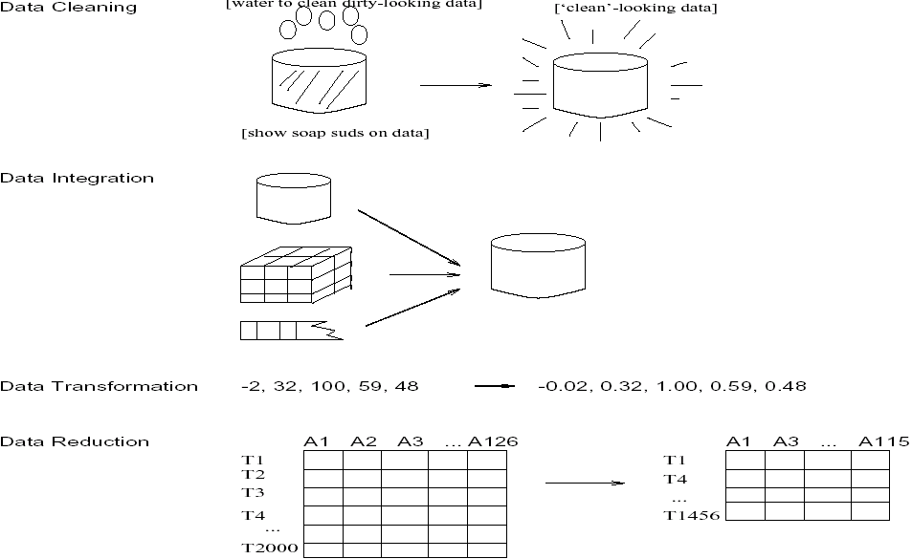
Forms of data preprocessing
SUSHIL KULKARNI

Slide 60
DATA CLEANING
SUSHIL KULKARNI

Slide 61
DATA CLEANING
Data cleaning tasks
  - Fill in missing values
  - Identify outliers and smooth out noisy data
  - Correct inconsistent data
SUSHIL KULKARNI
Notes:
A data mining system/query may generate thousands of patterns, not all of them are interesting.
Suggested approach: Human-centered, query-based, focused mining

Slide 62
HOW TO HANDLE MISSING DATA?
Ignore the tuple: usually done when class label is missing (assuming the tasks in classification)—not effective when the percentage of missing values per attribute varies considerably.
Fill in the missing value manually: tedious + infeasible?
SUSHIL KULKARNI
Notes:
A data mining system/query may generate thousands of patterns, not all of them are interesting.
Suggested approach: Human-centered, query-based, focused mining

Slide 63
HOW TO HANDLE MISSING DATA?
Use a global constant to fill in the missing value: e.g., “unknown”, a new class?!
Use the attribute mean to fill in the missing value
Use the attribute mean for all samples belonging to the same class to fill in the missing value: smarter
Use the most probable value to fill in the missing value: inference-based such as Bayesian formula or decision tree
SUSHIL KULKARNI
Notes:
A data mining system/query may generate thousands of patterns, not all of them are interesting.
Suggested approach: Human-centered, query-based, focused mining

Slide 64
HOW TO HANDLE MISSING DATA?
Age | Income | Team | Gender
23 | 24,200 | Red Sox | M
39 | ? | Yankees | F
45 | 45,390 | ? | F
Fill missing values using aggregate functions (e.g., average) or probabilistic estimates on global value distribution
E.g., put the average income here, or put the most probable income based on the fact that the person is 39 years old
E.g., put the most frequent team here
SUSHIL KULKARNI
Notes:
A data mining system/query may generate thousands of patterns, not all of them are interesting.
Suggested approach: Human-centered, query-based, focused mining

Slide 65
HOW TO HANDLE NOISY DATA?
Discretization
The process of partitioning continuous variables into categories is called Discretization.
SUSHIL KULKARNI
Notes:
A data mining system/query may generate thousands of patterns, not all of them are interesting.
Suggested approach: Human-centered, query-based, focused mining

Slide 66
HOW TO HANDLE NOISY DATA?
Discretization : Smoothing techniques
Binning method:
  - first sort data and partition into (equi-depth) bins
  - then one can smooth by bin means, smooth by bin median, smooth by bin boundaries, etc.
Clustering
  - detect and remove outliers
SUSHIL KULKARNI
Notes:
A data mining system/query may generate thousands of patterns, not all of them are interesting.
Suggested approach: Human-centered, query-based, focused mining

Slide 67
HOW TO HANDLE NOISY DATA?
Discretization : Smoothing techniques
Combined computer and human inspection
  - computer detects suspicious values, which are then checked by humans
Regression
  - smooth by fitting the data into regression functions
SUSHIL KULKARNI
Notes:
A data mining system/query may generate thousands of patterns, not all of them are interesting.
Suggested approach: Human-centered, query-based, focused mining

Slide 68
SIMPLE DISCRETISATION
METHODS: BINNING
Equal-width (distance) partitioning:
  - It divides the range into N intervals of equal size: uniform grid
  if A and B are the lowest and highest values of the attribute, the width of intervals will be:
  W = (B-A)/N.
  - The most straightforward
  - But outliers may dominate presentation
  - Skewed data is not handled well.
SUSHIL KULKARNI
Notes:
A data mining system/query may generate thousands of patterns, not all of them are interesting.
Suggested approach: Human-centered, query-based, focused mining

Slide 69
SIMPLE DISCRETISATION
METHODS: BINNING
Equal-depth (frequency) partitioning:
  - It divides the range into N intervals, each containing approximately same number of samples
  - Good data scaling – good handing of skewed data
SUSHIL KULKARNI
Notes:
A data mining system/query may generate thousands of patterns, not all of them are interesting.
Suggested approach: Human-centered, query-based, focused mining

Slide 70
BINNING : EXAMPLE
Binning is applied to each individual feature (attribute)
Set of values can then be discretized by replacing each value in the bin, by bin mean, bin median, bin boundaries.
Example Set of values of attribute Age:
0. 4 , 12, 16, 14, 18, 23, 26, 28
SUSHIL KULKARNI
Notes:
A data mining system/query may generate thousands of patterns, not all of them are interesting.
Suggested approach: Human-centered, query-based, focused mining

Slide 71
EXAMPLE: EQUI- WIDTH BINNING
Example : Set of values of attribute Age:
0. 4 , 12, 16, 16, 18, 23, 26, 28
Take bin width = 10
Bin # | Bin Elements | Bin Boundaries
1 | {0,4} | [ - , 10)
2 | { 12, 16, 16, 18 } | [10, 20)
3 | { 23, 26, 28 } | [ 20, +)
SUSHIL KULKARNI
Notes:
A data mining system/query may generate thousands of patterns, not all of them are interesting.
Suggested approach: Human-centered, query-based, focused mining

Slide 72
EXAMPLE: EQUI- DEPTH BINNING
Example : Set of values of attribute Age:
0. 4 , 12, 16, 16, 18, 23, 26, 28
Take bin depth = 3
Bin # | Bin Elements | Bin Boundaries
1 | {0,4, 12} | [ - , 14)
2 | { 16, 16, 18 } | [14, 21)
3 | { 23, 26, 28 } | [ 21, +)
SUSHIL KULKARNI
Notes:
A data mining system/query may generate thousands of patterns, not all of them are interesting.
Suggested approach: Human-centered, query-based, focused mining

Slide 73
SMOOTHING USING BINNING METHODS
Sorted data for price (in Rs): 4, 8, 9, 15, 21, 21, 24,
25, 26, 28, 29, 34
Partition into (equi-depth) bins:
- Bin 1: 4, 8, 9, 15
- Bin 2: 21, 21, 24, 25
- Bin 3: 26, 28, 29, 34
Smoothing by bin means:
- Bin 1: 9, 9, 9, 9
- Bin 2: 23, 23, 23, 23
- Bin 3: 29, 29, 29, 29
Smoothing by bin boundaries: [4,15],[21,25],[26,34]
- Bin 1: 4, 4, 4, 15
- Bin 2: 21, 21, 25, 25
- Bin 3: 26, 26, 26, 34
SUSHIL KULKARNI

Slide 74
SIMPLE DISCRETISATION METHODS: BINNING
number
of values
Example: customer ages
Equi-width binning:
0-10
10-20
20-30
30-40
40-50
50-60
60-70
70-80
Equi-depth binning:
0-22
22-31
48-55
62-80
38-44
32-38
44-48
55-62
SUSHIL KULKARNI

Slide 75
FEW TASKS
SUSHIL KULKARNI

Slide 76
BASIC DATA MINING TASKS
Clustering groups similar data together
into clusters.
  - Unsupervised learning
  - Segmentation
  - Partitioning
SUSHIL KULKARNI

Slide 77
CLUSTERING
Partitions data set into clusters, and models it by one representative from each cluster
Can be very effective if data is clustered but not if data is “smeared”
There are many choices of clustering definitions and clustering algorithms, more later!
SUSHIL KULKARNI

Slide 78
CLUSTER ANALYSIS
salary
cluster
outlier
age

Slide 79
CLASSIFICATION
Classification maps data into predefined groups or classes
  - Supervised learning
  - Pattern recognition
  Prediction
SUSHIL KULKARNI

Slide 80
REGRESSION
Regression is used to map a data item to a real valued prediction variable.
SUSHIL KULKARNI

Slide 81
REGRESSION
y
(salary)
Example of linear regression
Y1
y = x + 1
X1
x
(age)
SUSHIL KULKARNI

Slide 82
DATA
INTEGRATION
SUSHIL KULKARNI

Slide 83
DATA INTEGRATION
Data integration:
  combines data from multiple sources into a coherent store
Schema integration
  - Integrate metadata from different sources
    metadata: data about the data (i.e., data descriptors)
  Entity identification problem: identify real world entities from multiple data sources,
  e.g., A.cust-id ≡ B.cust-#
SUSHIL KULKARNI

Slide 84
DATA INTEGRATION
Detecting and resolving data value conflicts
  for the same real world entity, attribute values from different sources are different (e.g., S.A.Dixit.and Suhas Dixit may refer to the same person)
  possible reasons: different
  representations, different scales,
  e.g., metric vs. British units (inches vs.
  cm)
SUSHIL KULKARNI

Slide 85
DATA TRANSFORMATION
SUSHIL KULKARNI

Slide 86
DATA TRANSFORMATION
Smoothing: remove noise from data
Aggregation: summarization, data cube construction
Generalization: concept hierarchy climbing
SUSHIL KULKARNI

Slide 87
DATA TRANSFORMATION
Normalization: scaled to fall within a small, specified range
  - min-max normalization
  - z-score normalization
  normalization by decimal scaling
Attribute/feature construction
  - New attributes constructed from the given ones
SUSHIL KULKARNI

Slide 88
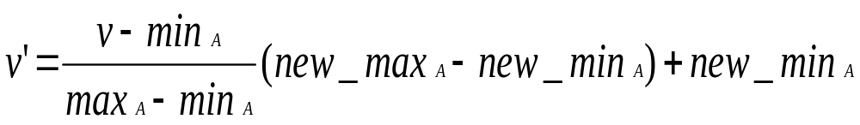
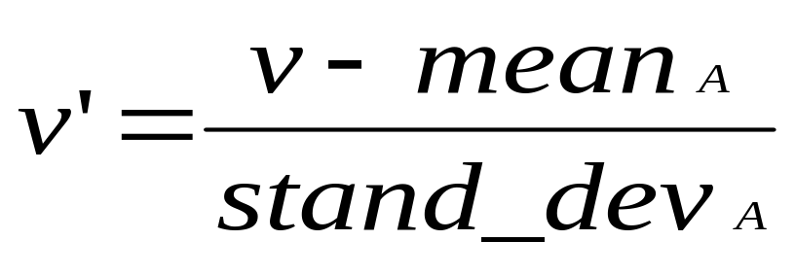
NORMALIZATION
min-max normalization
z-score normalization
SUSHIL KULKARNI

Slide 89
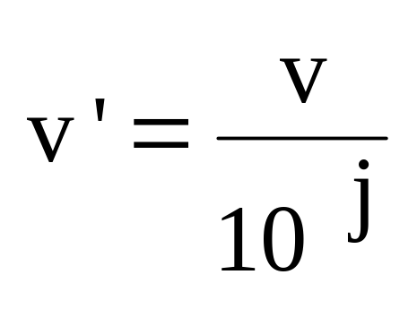
NORMALIZATION
normalization by decimal scaling
Where j is the smallest integer such that
Max(| V ‘ | ) <1
SUSHIL KULKARNI

Slide 90
SUMMARIZATION
Summarization maps data into subsets
with associated simple
- Descriptions.
  - Characterization
  Generalization
SUSHIL KULKARNI

Slide 91
DATA
EXTRACTION,
SELECTION,
CONSTRUCTION,
COMPRESSION
SUSHIL KULKARNI

Slide 92
TERMS
Extraction Feature:
A process extracts a set of new features from the original features through some functional mapping or transformations.
Selection Features:
It is a process that chooses a subset of M features from the original set of N features so that the feature space is optimally reduced according to certain criteria.
SUSHIL KULKARNI

Slide 93
TERMS
Construction feature:
It is a process that discovers missing information about the relationships between features and augments the space of features by inference or by creating additional features
Compression Feature:
A process to compress the information about the features.
SUSHIL KULKARNI

Slide 94
SELECTION:
DECISION TREE INDUCTION: Example
Initial attribute set:
{A1, A2, A3, A4, A5, A6}
A4 ?
A1?
A6?
Class 1
Class 2
Class 1
Class 2
>
Reduced attribute set: {A1, A4, A6}
SUSHIL KULKARNI

Slide 95
DATA COMPRESSION
String compression
- There are extensive theories and well-tuned
algorithms
  Typically lossless
  But only limited manipulation is possible without expansion
Audio/video compression:
  Typically lossy compression, with progressive refinement
  Sometimes small fragments of signal can be reconstructed without reconstructing the
  whole
SUSHIL KULKARNI

Slide 96
DATA COMPRESSION
Time sequence is not audio
  Typically short and varies slowly with time
SUSHIL KULKARNI

Slide 97
DATA COMPRESSION
Original Data
Compressed
Data
lossless
Original Data
Approximated
lossy
SUSHIL KULKARNI

Slide 98
NUMEROSITY REDUCTION:
Reduce the volume of data
Parametric methods
  Assume the data fits some model, estimate model parameters, store only the parameters, and discard the data (except possible outliers)
  Log-linear models: obtain value at a point in m-D space as the product on appropriate marginal subspaces
Non-parametric methods
  Do not assume models
  Major families: histograms, clustering,
  sampling
SUSHIL KULKARNI

Slide 99
HISTOGRAM
Popular data reduction technique
Divide data into buckets and store
average (or sum) for each bucket
Can be constructed optimally in one dimension using dynamic programming
Related to quantization problems.
SUSHIL KULKARNI

Slide 100

HISTOGRAM
SUSHIL KULKARNI

Slide 101
HISTOGRAM TYPES
Equal-width histograms:
  It divides the range into N intervals of equal size
Equal-depth (frequency) partitioning:
  It divides the range into N intervals, each containing approximately same number of samples
SUSHIL KULKARNI

Slide 102
HISTOGRAM TYPES
V-optimal:
  It considers all histogram types for a given number of buckets and chooses the one with the least variance.
MaxDiff:
  After sorting the data to be approximated, it defines the borders of the buckets at points where the adjacent values have the maximum difference
SUSHIL KULKARNI

Slide 103
HISTOGRAM TYPES
EXAMPLE; Split to three buckets
1,1,4,5,5,7,9, 14,16,18, 27,30,30,32
1,1,4,5,5,7,9, 14,16,18, 27,30,30,32
    MaxDiff 27-18 and 14-9
SUSHIL KULKARNI

Slide 104
HIERARCHICAL REDUCTION
Use multi-resolution structure with different degrees of reduction
Hierarchical clustering is often performed but tends to define partitions of data sets rather than “clusters”
SUSHIL KULKARNI

Slide 105
HIERARCHICAL REDUCTION
Hierarchical aggregation
  An index tree hierarchically divides a data set into partitions by value range of some attributes
  Each partition can be considered as a bucket
  Thus an index tree with aggregates stored at each node is a hierarchical histogram
SUSHIL KULKARNI

Slide 106
MULTIDIMENSIONAL INDEX
STRUCTURES CAN BE USED FOR
DATA REDUCTION
Example: an R-tree
R1
R3
R0
R0:
R0 (0)
b
R1
R2
a
g
R2
R1:
R3
R4
R2:
R5
R6
i
R6
f
d
h
R4
R3:
R4:
R5:
R6:
c
a
b
d
g
h
c
i
e
f
R5
e
Each level of the tree can be used to define a milti-dimensional equi-depth histogram
E.g., R3,R4,R5,R6 define multidimensional buckets which approximate the points
SUSHIL KULKARNI

Slide 107
SAMPLING
Allow a mining algorithm to run in complexity that is potentially sub-linear to the size of the data
Choose a representative subset of the data
- Simple random sampling may have very poor
performance in the presence of skew
SUSHIL KULKARNI

Slide 108
SAMPLING
Develop adaptive sampling methods
  Stratified sampling:
    Approximate the percentage of each class (or subpopulation of interest) in the overall database
    Used in conjunction with skewed data
Sampling may not reduce database I/Os (page at a time).
SUSHIL KULKARNI

Slide 109
SAMPLING
SRSWOR
(simple random
sample without
replacement)
SRSWR
Raw Data
SUSHIL KULKARNI

Slide 110
SAMPLING
Raw Data
Cluster/Stratified Sample
The number of samples drawn from each
cluster/stratum is analogous to its size
Thus, the samples represent better the
data and outliers are avoided
SUSHIL KULKARNI

Slide 111
LINK ANALYSIS
Link Analysis uncovers relationships
among data.
  - Affinity Analysis
  - Association Rules
  - Sequential Analysis determines sequential patterns
SUSHIL KULKARNI

Slide 112
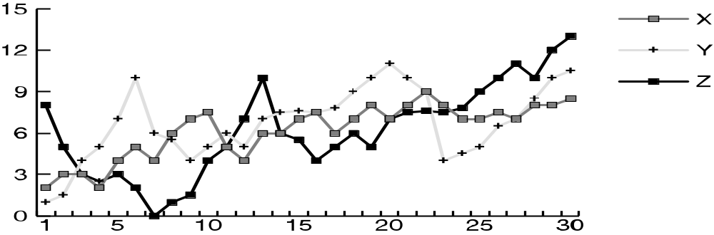
EX: TIME SERIES ANALYSIS
Example: Stock Market
Predict future values
Determine similar patterns over time
Classify behavior
SUSHIL KULKARNI

Slide 113
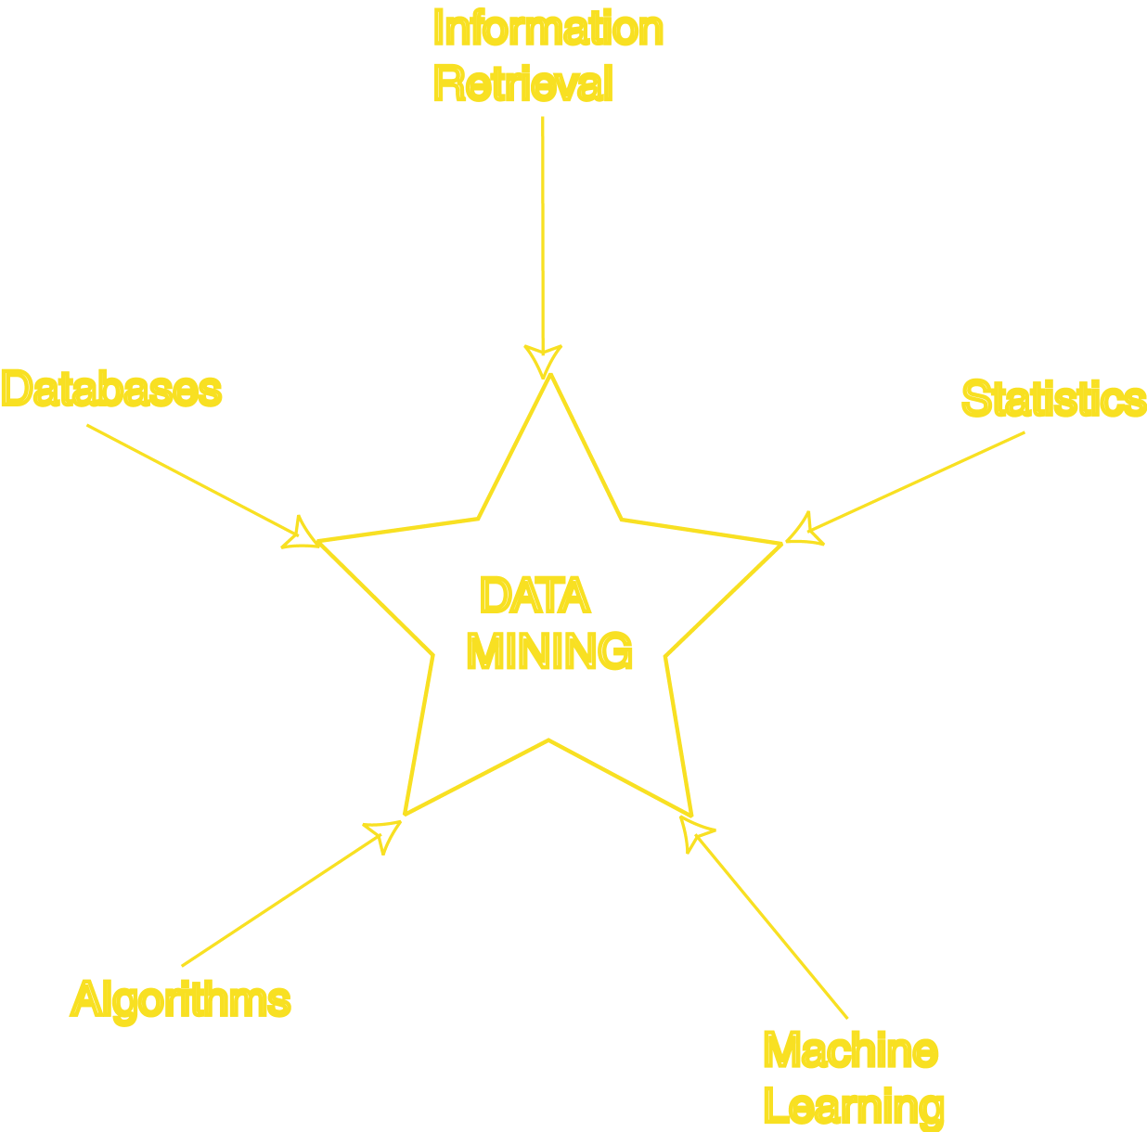
DATA MINING DEVELOPMENT
Similarity Measures
Hierarchical Clustering
IR Systems
Imprecise Queries
Textual Data
Web Search Engines
Relational Data Model
SQL
Association Rule Algorithms
Data Warehousing
Scalability Techniques
Bayes Theorem
Regression Analysis
EM Algorithm
K-Means Clustering
Time Series Analysis
Algorithm Design Techniques
Algorithm Analysis
Data Structures
Neural Networks
Decision Tree
Algorithms
SUSHIL KULKARNI

Slide 114

INTENSIONS
List the various data mining metrics
What are the different visualization techniques of data mining?
Write short note on “Database perspective of data mining”
Write short note on each of the related concepts of data mining
SUSHIL KULKARNI

Slide 115
VIEW DATA USING
DATA MINING
SUSHIL KULKARNI

Slide 116
DATA MINING METRICS
Usefulness
Return on Investment (ROI)
Accuracy
Space/Time
SUSHIL KULKARNI

Slide 117
VISUALIZATION TECHNIQUES
Graphical
Geometric
Icon-based
Pixel-based
Hierarchical
Hybrid
SUSHIL KULKARNI

Slide 118
DATA BASE PERSPECTIVE ON DATA MINING
Scalability
Real World Data
Updates
Ease of Use
SUSHIL KULKARNI

Slide 119
RELATED CONCEPTS OUTLINE
Goal: Examine some areas which are related to data mining.
Database/OLTP Systems
Fuzzy Sets and Logic
Information Retrieval(Web Search Engines)
Dimensional Modeling
SUSHIL KULKARNI

Slide 120
RELATED CONCEPTS OUTLINE
Data Warehousing
OLAP
Statistics
Machine Learning
Pattern Matching
SUSHIL KULKARNI

Slide 121
DB AND OLTP SYSTEMS
Schema
  (ID,Name,Address,Salary,JobNo)
Data Model
  ER AND Relational
Transaction
Query:
    SELECT Name
    FROM T
    WHERE Salary > 10000
    DM: Only imprecise queries
SUSHIL KULKARNI

Slide 122
FUZZY SETS AND LOGIC
Fuzzy Set: Set membership function is a real valued function with output in the range [0,1].
f(x): Probability x is in F.
1-f(x): Probability x is not in F.
Example:
T = {x | x is a person and x is tall} Let f(x) be the probability that x is tall.
Here f is the membership function
DM: Prediction and classification
are fuzzy.
SUSHIL KULKARNI

Slide 123
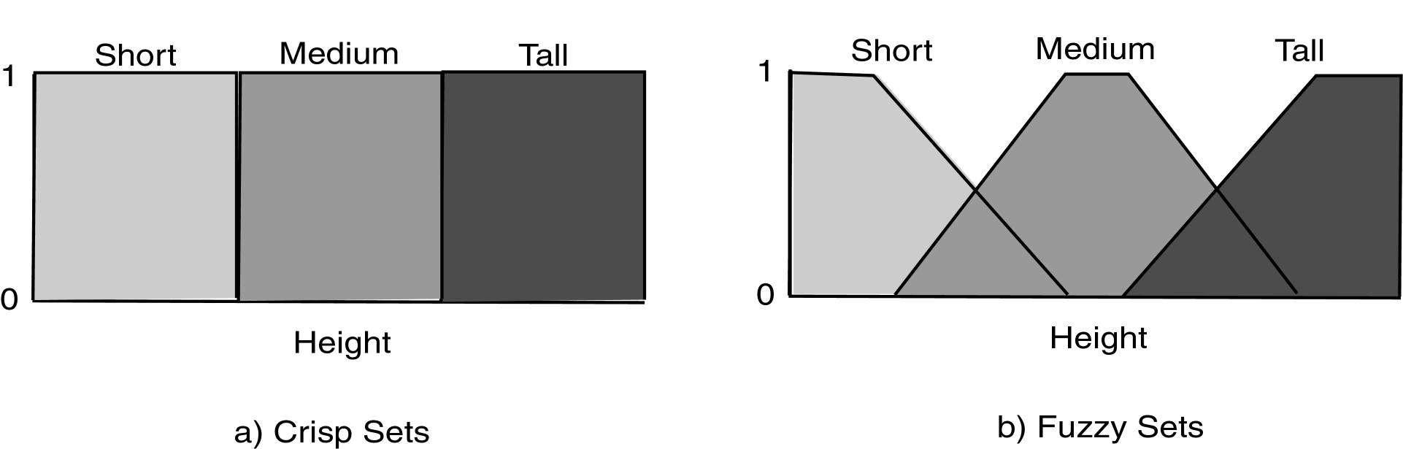
FUZZY SETS
SUSHIL KULKARNI

Slide 124
FUZZY SETS
Fuzzy set shows the triangular view of set of member ship values are shown in fuzzy set
There is gradual decrease in the set of values of short, gradual increase and decrease in the set of values of median and, gradual increase in the set of values of tall.
SUSHIL KULKARNI

Slide 125
CLASSIFICATION/ PREDICTION IS FUZZY
Loan
Amnt
Reject
Reject
Accept
Accept
Simple
Fuzzy
SUSHIL KULKARNI

Slide 126
INFORMATION RETRIEVAL
Information Retrieval (IR): retrieving
desired information from textual data.
1. Library Science 2. Digital Libraries
3. Web Search Engines
4.Traditionally keyword based
Sample query:
  “Find all documents about “data mining”.
  DM: Similarity measures; Mine text/Web
  data.
SUSHIL KULKARNI

Slide 127
INFORMATION RETRIEVAL
Similarity: measure of how close a query is to a document.
Documents which are “close enough” are retrieved.
Metrics:
  Precision = |Relevant and Retrieved|
  |Retrieved|
  Recall = |Relevant and Retrieved|
  |Relevant|
SUSHIL KULKARNI

Slide 128
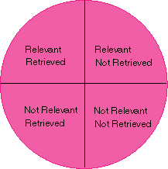
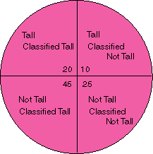
IR QUERY RESULT MEASURES AND CLASSIFICATION
IR
Classification
SUSHIL KULKARNI

Slide 129
DIMENSION MODELING
View data in a hierarchical manner more as business executives might
Useful in decision support systems and mining
Dimension: collection of logically related attributes; axis for modeling data.
SUSHIL KULKARNI

Slide 130
DIMENSION MODELING
Facts: data stored
Example: Dimensions – products, locations, date
Facts – quantity, unit price
DM: May view data as dimensional.
SUSHIL KULKARNI

Slide 131
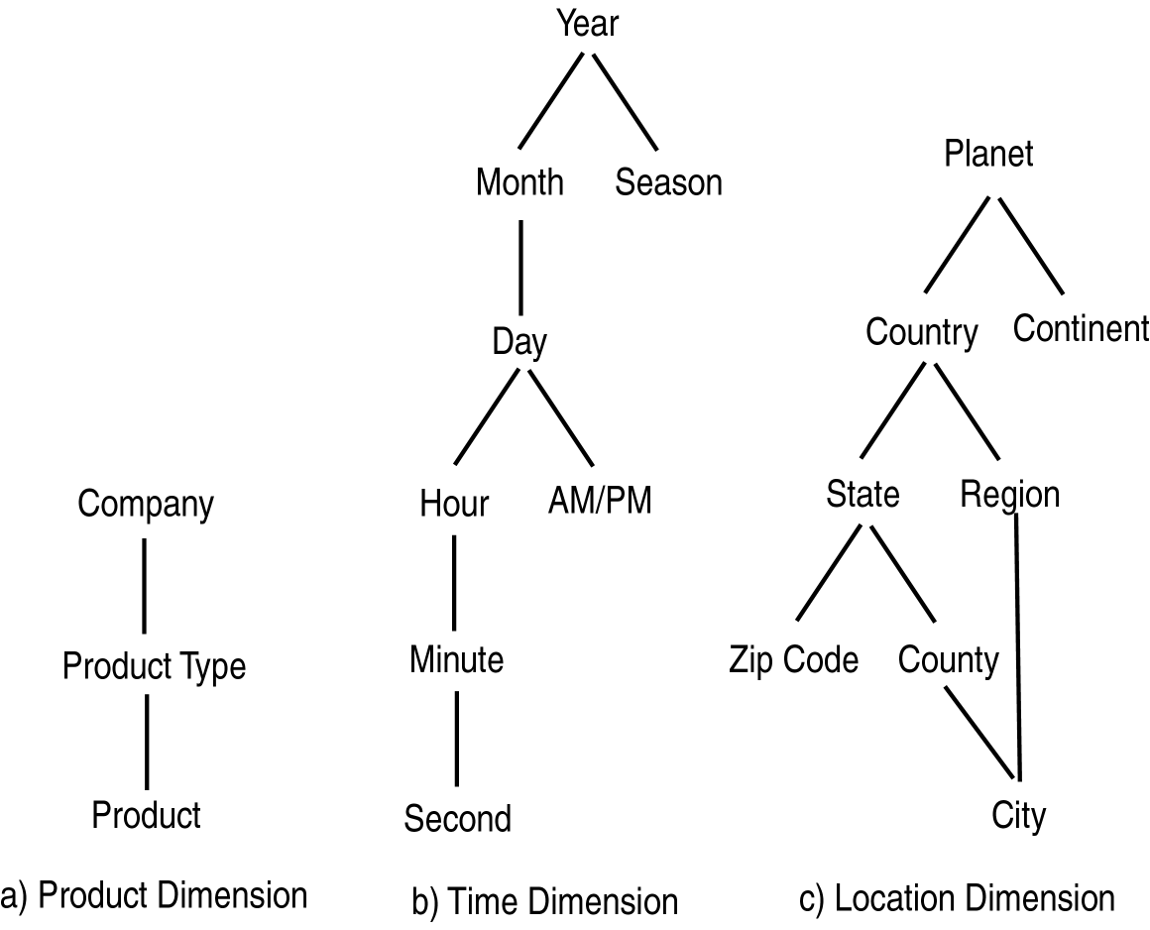
AGGREGATION HIERARCHIES
SUSHIL KULKARNI

Slide 132
STATISTICS
Simple descriptive models
Statistical inference: generalizing a model created from a sample of the data to the entire dataset.
Exploratory Data Analysis:
  1.Data can actually drive the creation of the model
  2.Opposite of traditional statistical
  view.
SUSHIL KULKARNI

Slide 133
STATISTICS
Data mining targeted to business user
DM: Many data mining methods come
from statistical techniques.
SUSHIL KULKARNI

Slide 134
MACHINE LEARNING
Machine Learning: area of AI that examines how to write programs that can learn.
Often used in classification and prediction
Supervised Learning: learns by example.
SUSHIL KULKARNI

Slide 135
MACHINE LEARNING
Unsupervised Learning: learns without knowledge of correct answers.
Machine learning often deals with small static datasets.
DM: Uses many machine learning techniques.
SUSHIL KULKARNI

Slide 136
PATTERN MATCHING (RECOGNITION)
Pattern Matching: finds occurrences of a predefined pattern in the data.
Applications include speech recognition, information retrieval, time series analysis.
DM: Type of classification.
SUSHIL KULKARNI

Slide 137

T H A N K S !
SUSHIL KULKARNI

